Slide 1

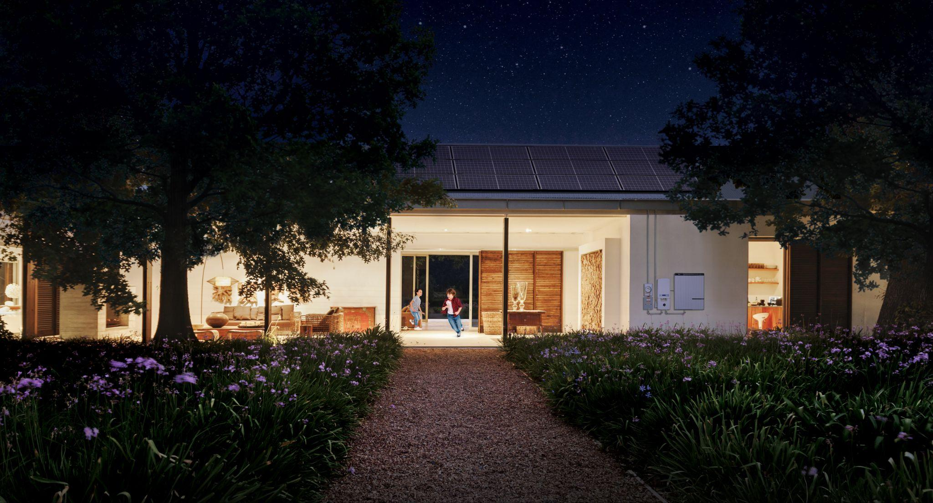

The Grid of the Future Starts at Home
Thad Culley, Sr. Director of Regulatory Policy

Slide 2
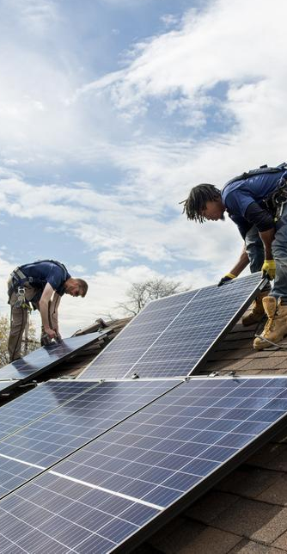
Commitment to Our Future, Together
We believe in a customer-led clean energy future
2007 Changed solar industry with solar-as-a-service model for home solar
2016 Batteries added as option to provide resiliency for homes & the grid
2019 Won bid for first residential virtual power plant in wholesale market
2025 Running VPPs across the country with over 100,000 customers
OUR IMPACT
7GW+ installed solar capacity
Installing equivalent of 1 nuclear plant per year
Over 1.1M customers; 236,000+ solar+storage systems (4 GWh of dispatchable potential)
Over 106,000 customers with batteries currently participating in grid services (VPP/DPP) reaching 425 MW of peak dispatch in 2025.
22 states plus DC and Puerto Rico

Slide 3
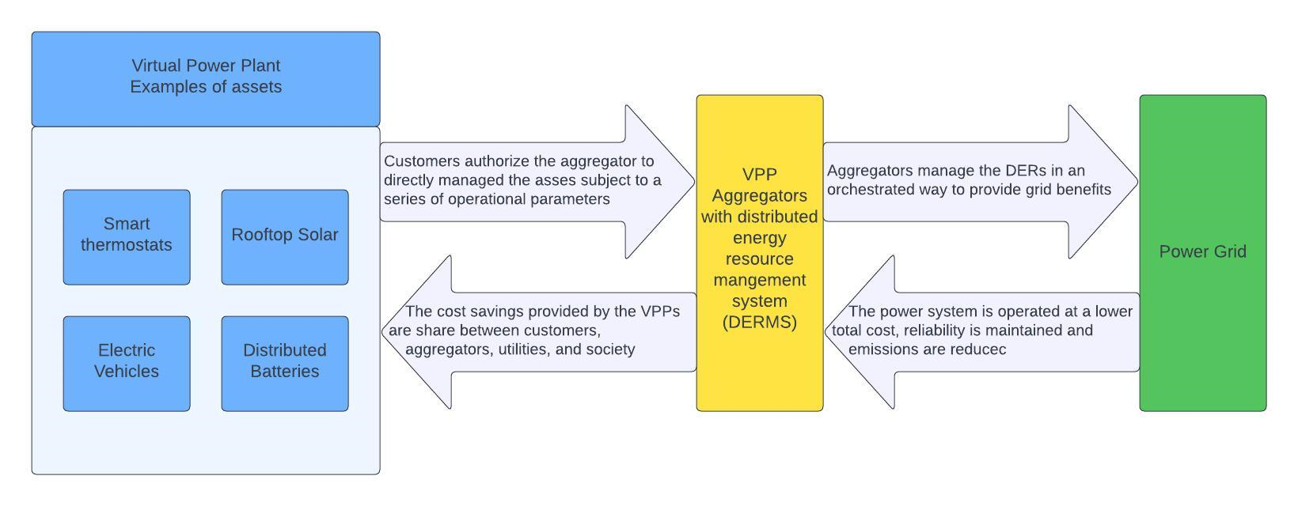
What is a Distributed Power Plant? (DPP)
VPP Use Cases
Backup power
TOU management
Self-consumption
Peak load reduction, load shifting
Ancillary Services
Reduce congestion
Defer distribution upgrade
A VPP is a portfolio of actively controlled distributed energy resources (DERs). Operation of the DERs is optimized to provide benefits to the power system, consumers and the environment.

Slide 4
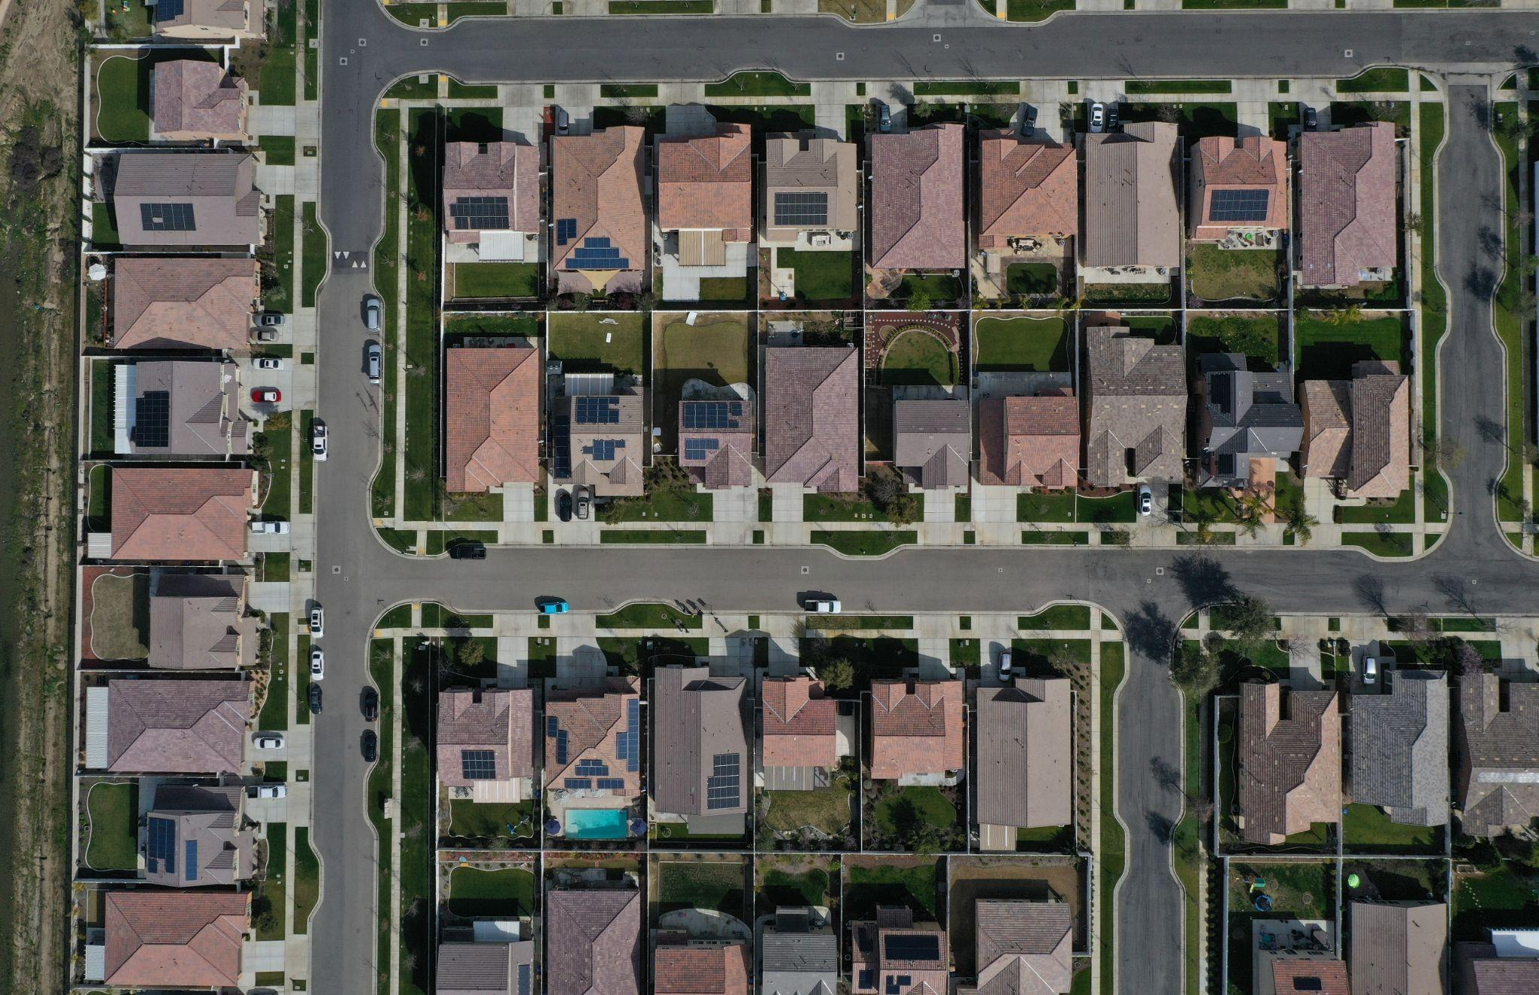

DPP/VPPs Needed Today for Reliability
Critical Tool for Affordable, Flexible Grid
Increasing electricity demand is pushing our grid to its limits and increasing costs. New energy demand is projected to double.
140M+ people in 40 states dealt with calls to conserve or blackouts due to extreme weather & peak constraints in 2022.
How can we quickly utilize existing infrastructure and private investment to increase reliability and reduce demand?
VPPS UTILIZE FAST & SCALABLE POWER
Maximizing Benefits: ISO-NE 2023 report: distributed solar reduced peak load in NE on 5 hottest days, by 1-1.5 GW. ~ large power plant
Substantial Cost Savings: DERs could offset $15-35B in ratepayer-funded capacity investment over 10 years. Brattle Report

Slide 5


Current & Proposed VPPs with Injections to Grid
Specific VPPs Designed to Leverage Solar+Storage with Export into Grid
STATE PROGRAMS
OPEN ACCESS
UTILITY-LED
NV
Stephen Lassiter, Walker
UT
Chris
Worley
CO
Chris Worley
WHOLESALE MARKETS
VERY LIMITED
FERC 2222 DELAYS & CHALLENGES
Active S+S VPP
Proposed / In Development
Potential

Slide 6
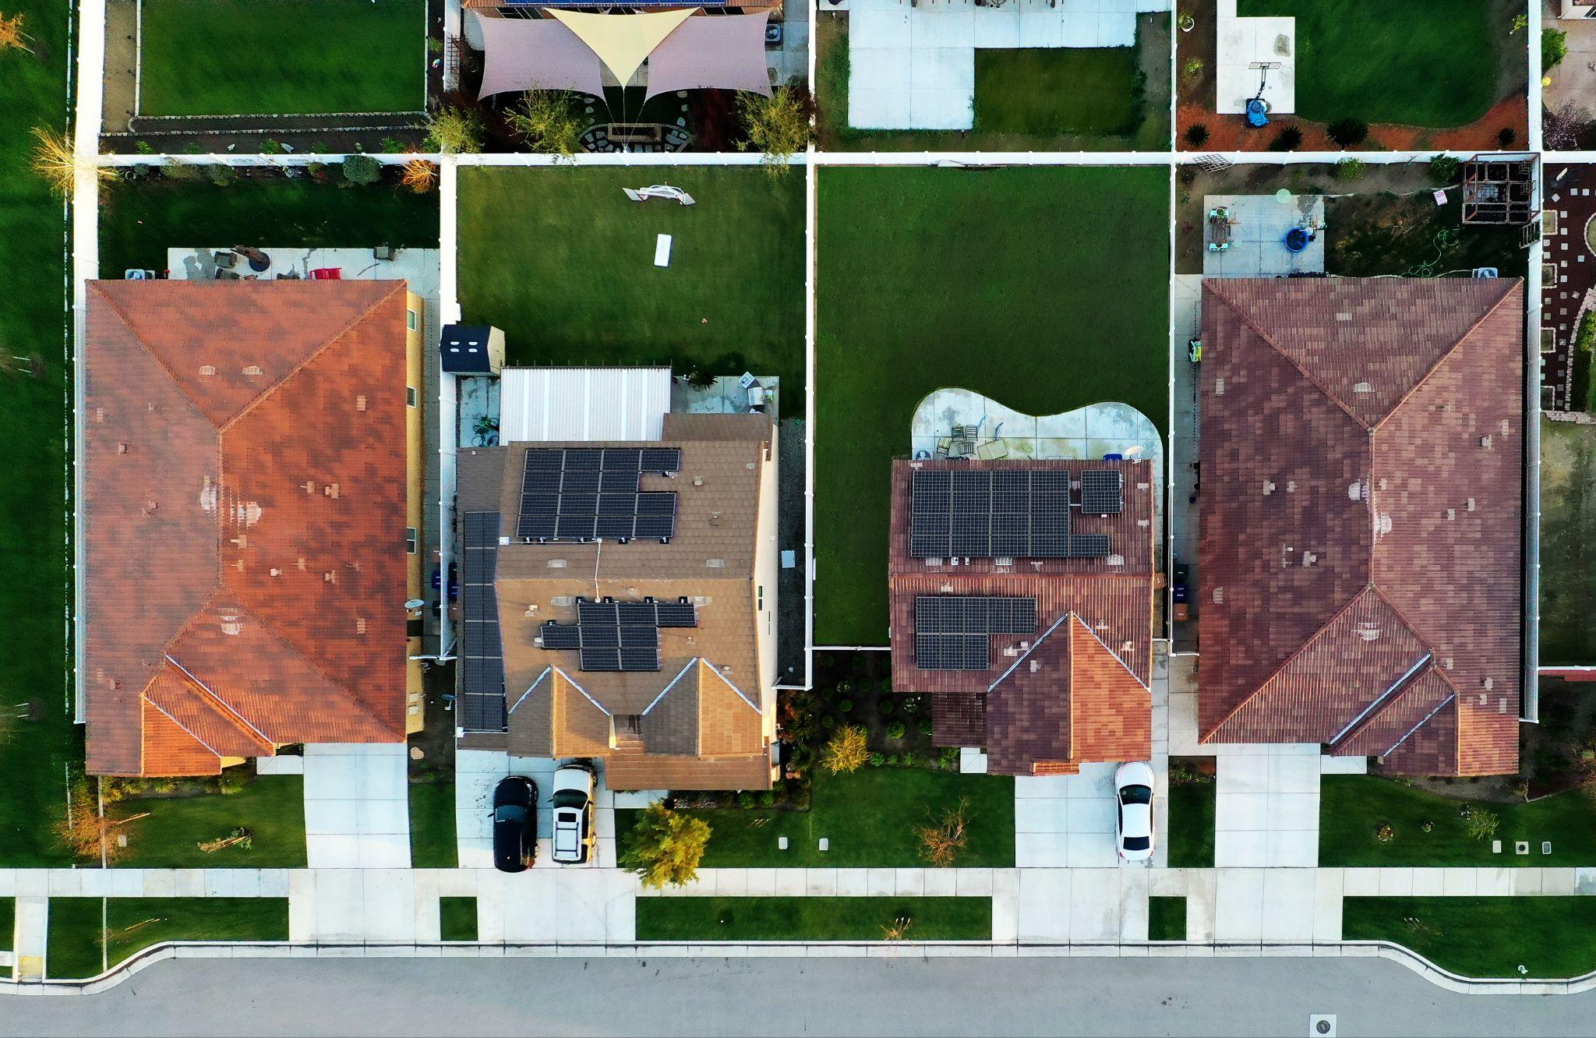
State DPP/VPP Programs:
Peak Load Reduction with Injection to Grid
Framework
State developed programs or Utility proposed limited programs
Reduce peak load at specific times to best suit state needs
Dispatchable: Exporting electrons from aggregated batteries
Pay for performance compensation
Additional payments at grid edge or areas impacted by outages
Robust enrollment from diverse products, customers, geography
Commission
Launch discussion
Program parameters
Evaluation
Utility
Identify Need
Dispatch signal
Internally or DERMS
Aggregator
Enrolls customers
Dispatches
O&M, Monitoring
Customer
Seamless interaction
No lifestyle impacts
Reliability +

Slide 7
State Program Examples
PowerPair: North Carolina
60 MW Solar+Storage pilot
Compensation: Upfront enrollment payment
Optionality for customers:
TOU-CPP rate with no dispatch requirements
Flat retail rate with additional performance credit on monthly bill
ConnectedSolutions: MA, RI, CT
Seasonal peak load reduction program with dispatch
Compensation: Pay-for-Performance Program
  Provides O&M stability AND customer awareness, satisfaction
  5 year enrollment with set payment terms
No more than 60 events per year
2-3 hours of performance per event
Seasonal (can be annual or two-seasons depending on needs)
Storm provision

Slide 8
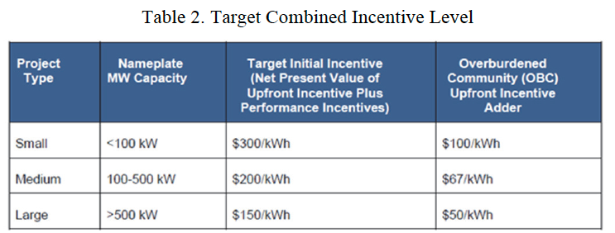
Garden State Energy Storage Program
Phase 2 Straw Proposal
Lengthy regulatory process (multiple iterations and open comment periods)
BPU Staff Straw Proposal contemplates a combination of upfront incentives and “ConnectedSolutions”-style pay-for-performance
  Values would be proposed in utility filings.
  Determined that Phase 2 would move forward at some yet to be determined time in 2026
Gov. Sherrill EO #2 requires BPU to initiate proceeding establishing a VPP within 180 days (we just hit the halfway point)

Slide 9
JCP&L (program example)
Tesla offers a battery VPP through JCP&L’s Energy Savings Reward Program.
Pays $100/kW for average performance
  Tesla calculates a single Powerwall 3 could earn up to $360 annually through the program
Appears to be limited to stand-along batteries (i.e., not solar+storage facilities engaged in net metering)

Slide 10
Recommendations to Move Forward
Create Pathway for S+S VPP Program that leverages export of electrons
Commissions can call for idea: Sandbox or Docket
Allow utilities to propose, but don’t wait
Set timeline goal to launch
Keep it Simple
Pilots with direction to expand
Start with critical peak load reduction needs
Worry about complicated grid services later, build confidence today
Grid Ready Interconnection
Drive rapid, equitable deployment of customer-sited solutions
Update IX rules or allow Grid Ready IX Pilot - home systems include:
1) Set, stable fee for all
2) Smart inverter functions to allow for quick IX, open feeders
3) Clarify NEM eligiblity

